Slide 1
Predicting Consumer Demand in an Insurance Environment
Scott Foran Hall ID#326360
MIS 581 – Capstone: Business Intelligence and Data Analytics, CSU Global
Mod 8: Portfolio project Presentation
Professor – Dr. Justin Bateh

Slide 2
Introduction – Demand modeling in an insurance corp content overview
Introduction of the business and overview of the project
Objectives
Research Questions
Associated Hypotheses
Research design
Methodology used
Limitations
Ethical Considerations
Findings – results from analysis
Conclusion and Recommendations
Notes:
The organization we are reviewing (AmFam) is a large-scale insurer with a lot of different components. From claims adjusters to corner agents to IT, there are dozens of different roles with multiple layers of management.

Slide 3

Introduction: AmFam business
The property insurance industry provides services to more than 85% of adults in the US.
To serve them well, there are many needs
Gartner accolades - #1 in execution, great places to work
Number 1 in customer satisfaction
Figure 1 - AmFam Logo
Note: Overview of Workday HCM system shows login dashboard functionality (workday.com/en-us/products/human-capital-management/overview.html)
Notes:
Notes –
To serve them well, there are many needs
Quotes, Claims, Service
Different products
Perhaps most important, understanding the customers’ needs, and meeting them where they are to solve for those needs is a top priority

Slide 4
Overview: Objectives of the research
The objectives of the research will therefore be to leverage reliable, accessible data and use it to create a reliable demand model to plan around, with the following supporting objective components in mind:
Improve understanding of reliable customer behavior, associated patterns
Plan for sales and service staffing needs
Provide insights around seasonality, holiday demand changes
Understand intraweek, monthly trends and variability
Notes:
To add little more information regarding goals, this stated objective increases the likelihood that the aim of gaining better understanding of customer behavior, and the associated aims of understanding and creating plans around those trends can be achieved.
Additionally, the insurance industry is becoming more data rich every day, offering understanding more about prospects, clients, traffic, and claims.
And while there is no shortage of business problems, many of those questions are already being explored, while the aim of better understanding customer demand traffic remains largely un-tapped.

Slide 5
Research: business Questions
With that in mind, here are the resulting problem statement and associated business question(s):
Problem statement: “The business has a need to understand consumer demand, therefore understanding reliable patterns related to that demand should be pursued.”
Research Questions:
Does the day of the week impact consumer behavior?
Do seasonal changes cause volatility?
Can the resulting information be actionable?
Notes:
This problem statement helps define a clear focus, and associated business questions listed above should help determine whether that problem can be solved. And the aim will be to determine whether those questions can lead to clear answers.
Null Hypothesis: Statistical modeling, leveraging 15-20+ customer behavior attributes will NOT allow creation of a propensity model that provides trends around when and where customers need assistance.
The null hypothesis is deemed to be false, with a high level of confidence. This tells us that the data utilized in the study, and the associated tests, research and analysis are a sound foundation for this business practice and process adoption.

Slide 6
Research design
Several tools and tactics were deployed, including:
Alteryx was utilized to extract and connect data elements together, for a useable data set.
Python is a tool that in this case can take advantage of a structured, pliable dataset and perform a variety of different model types
MS Excel is used as a way to sort, clean and check some of the data and the associated tests mentioned above. To complete some of those checks, the solver tool was utilized as well.
Notes:
These tools were used to perform a variety of different model types, to determine the best possible solutions and fit.
Some of the models reviewed were multivariate regression test, which is designed to evaluate how multiple variables influence a particular outcome, and partial least squares, which helps “perfect” the amount of input from each variable by pursuing the best approach.
For instance, with this research, does it matter if a holiday falls on a Monday in the Summer, and how do those three different variables (Holiday, Day of Week, Time of Year) interact or combine to affect customer behavior.

Slide 7
Ethical considerations, limitations
The biggest factor within this research is that customer behavior is being tracked and analyzed.
There is no personal privacy concern for individuals, as this data would be utilized and aggregated by day, and by customer channel (emails, chats, phone calls, social media, etc).
Limitations -Additionally, a model will not be able to account for changes in outside situations or environment. For example:
Economic challenges and recessions
Unemployment volatility
Civil unrest
Notes:
Ethical Concerns: many companies are aggregating customer behavioral information for better planning and customer habits, and the data for this experiment is no different. Ultimately the planning and related benefits to the overall customer experience should be a good trade off, however, it may make sense to ensure consumers are notified and aware of the usage of this data, and its various purposes.
Limitations – list above
As can be interpreted, these situations are all “disruptors” and could throw off a model that banks on reliable historical patterns.

Slide 8
Analytics results and findings
The analysis for this program involves several steps, they are:
Data elements - collection methods, description
Gathering the needed data elements into one location, via ETL
Determining model type
Setting up and running the model
Reviewing the results and identifying key factors
Conclusion/Recommendations
Notes:
Data Elements - Collection
This data is collected in a few ways, some more reliable than others. Beginning with physical locations, agencies do track customer calls and “pop in’s”, and have good, automated capture of every quote or customer contact being generated.
The data categories will fall into the following groups:
Customer Sales Inquiries
Count per day
Internet vs retail
Other contact channels
Customer service inquiries
Phone Support
General inquiries

Slide 9
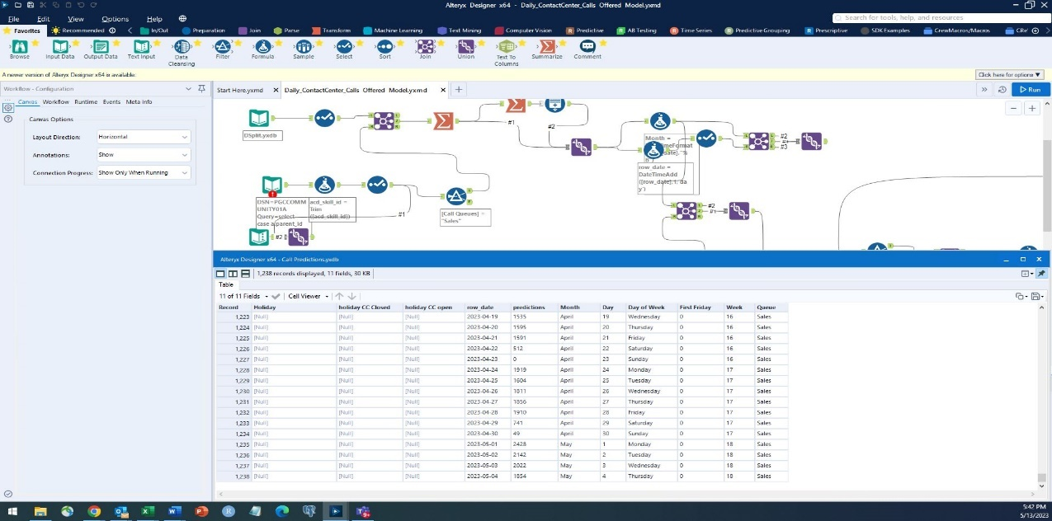
Data extraction - etl
Figure 2 Alteryx – Sample Workflow
To gather the various data elements, an ETL process was required, utilizing Alteryx.
Alteryx enabled joining of disparate datasets using join points, in this case a phone number or other unique set of customer identifiers. Below are a couple of screenshots of the workflow itself in figure 3.
Note – Data results provided by Scott Hall
Notes:
As can be interpreted, the process for getting the dataset is somewhat lengthy, but provides a good base to work within. Regarding data cleansing, the data is generally clean, but it was reviewed to ensure there are no incomplete results, and that data falling our of normal range (+- 20% from the base mean) is accurate and explainable.

Slide 10
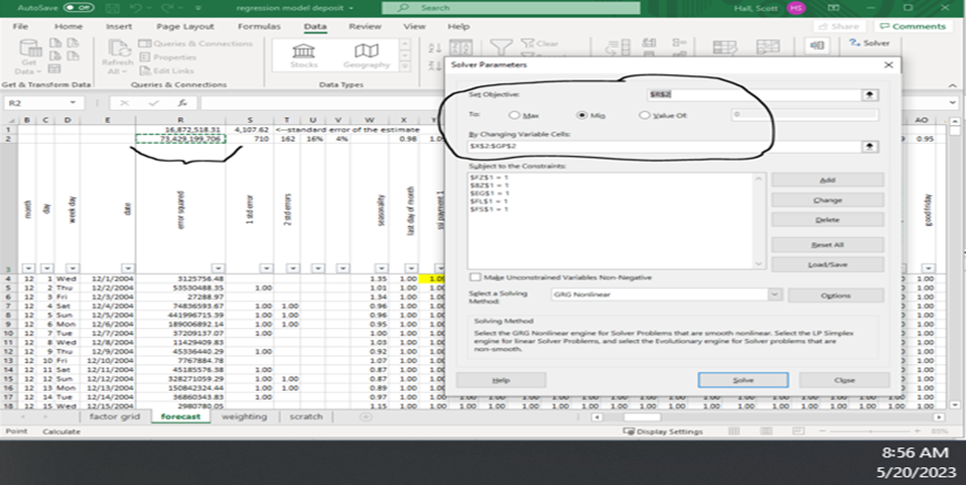
Data analysis – Model types
Figure 3 Partial Least Squares Process – Solver
Two types of models were reviewed for this research
Linear Regression
Python based
Pros/Cons
Partial Least Squares
Excel Based
Pros/Cons
Note – Data results provided by Scott Hall
Notes:
Two types of models were reviewed – both have their ups and downs
- Linear regression was utilized, and worked relatively well, returning P values in the mid to high .7’s for key variables like day of week and holidays
- The model was a bit more challenged when adding more than three or four variables
- Partial Least Squares models are a bit more challenging to set up and administrate at first…
- however…(next slide)

Slide 11
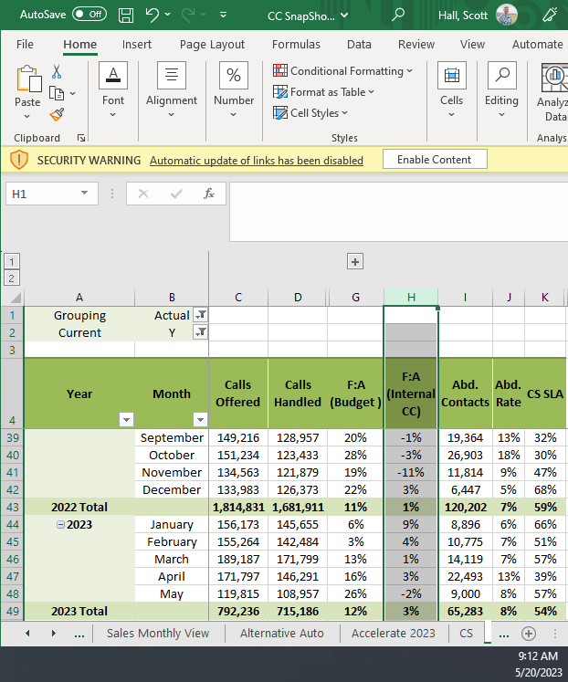
Data analysis – partial least squares
The model being recommended is the partial least squares variation. Results shown below.
Figure 3 Partial Least Squares Process – Forecast Results
Note – Data results provided by Scott Hall
Notes:
Partial Least Squares models again can be a bit more challenging to set up and administrate at first…
But, there are some positives
- Can handle many variables
- Will find the best combination or “fit” based on thousands of combinations of co-efficients/constant
- Can be converted to a machine learning model, with low maintenance
Ultimately this model proved to be the most reliable, with most monthly forecasts coming within +- 3 ppts

Slide 12
Results
The monthly forecast (highlighted cells) from the least squares forecast model is quite reliable
Most months coming within +- 2-3% variance
The daily results from the model are similar to the linear regression, +- ~6-8%
More on final analysis and recommendations is summarized below.
Notes:
Most months were very accurate (aside from some outlier months such as November 2022, which was impacted by localized economic stimulus programs.)
The daily results from the model are similar to the linear regression, running +- ~6-8%, however there was some skewing related to seasonality that would likely improve the accuracy over time following some additional tuning and perhaps a new variable or two.
In short, the process of utilizing historical customer demand data, and applying time series factors such as day of week and holidays does appear to prove the theories and answer the associated questions.

Slide 13
Conclusion
Providing directional guidance within a reasonable margin of error, allowing the business to plan for expected customer behavior.
To revisit the Null Hypothesis, the statement is as follows:
Null Hypothesis: Statistical modeling, leveraging 15-20+ customer behavior attributes will NOT allow creation of a propensity model that provides trends around when and where customers need assistance.
The null hypothesis is deemed to be false, with a high level of confidence. This tells us that the data utilized in the study, and the associated tests, research and analysis are a sound foundation for this business practice and process adoption.
And with the related business questions aimed at providing better availability of resources when and where clients need them, there are opportunities to enable tactics that will improve planning, and ultimately offer a better customer experience.
Notes:
As mentioned, two different types of models, linear regression, and partial least squares both provided significant capabilities for predictive modeling consumer demand in the insurance environment, with the least squares model slightly outperforming the linear regression, but both achieving the desired result of providing directional guidance within a reasonable margin of error, allowing the business to plan for expected customer behavior.
Results from the Hypotheses

Slide 14
recommendations
First, the ROI step should be taken first, this step should be done to evaluate the hard costs from current inefficiencies
A determination of what a 3-4% improvement in those categories would provide in total expense/revenue benefit
The predictive model should utilize organized data capture of customer contacts from all channels with the following attributes: date, day of week, customer ID, channel, IVR/other path.
Notes:
The ROI step should be done to evaluate the hard costs from current inefficiencies, including things such as; opportunities to capture and service abandoned customers such as Customers who think the wait time is too long at certain times, as well as Customers who disconnect after waiting in line. Additionally, a determination should be made regarding the costs from lower occupancy during certain days/times.
Next, what a 3-4% improvement in those categories would provide in total expense/revenue benefit, then subtract the cost of two full time analysts to determine total cost benefit. Assuming the ROI is positive, the business should implement a full-scale predictive model for customer traffic.
The predictive model should utilize organized data capture of customer contacts from all channels with the following attributes: date, day of week, customer ID, channel, IVR/other path. From there, the organization should deploy a multivariate model, using either the linear or least squares regression method using software tool(s) of choice (Python, Excel, Alteryx, etc). P values and error rates utilizing r^2 values should be completed for model decision. The capture baseline (average daily volume) by channel is an additional step that should be taken, and the capture of co-efficient factors for every measured variable (day of week, time of month, day after major holiday, etc). The model should apply layered factors to baseline volume to enable future daily forecast

Slide 15
Recommendations continued
Measurement – the process should be tested and measure after 4-6 weeks, then reviewed for accuracy.
Once the model is averaging ~+-5% forecast accuracy on most days (85+%), it can be deployed. Model accuracy should improve slightly over time as more data is ingested
Operational actions - once reliable, staffing adjustments can be made based on higher/lower forecasts, and using creative staffing techniques such as;
Rotating weekends, flexible schedules, etc.
Management can also explore supplementing human resources with tier 1 automation options, improved self-servicing tools,
Mobile App improvements and Voice Ai and other augmentation.
Notes:
In supposition, the implementation of a predictive model providing forecast data of customer demand traffic will provide the organization with great tools for improved planning and overall business optimization, for it’s clients, employees and it’s bottom line. Thank you for your time and consideration.

Slide 16
References
Scholarly Articles and Resources
Wouter Verbeke; Bart Baesens; Cristian Bravo. Profit Driven Business Analytics : A Practitioner's Guide to Transforming Big Data Into
Added Value Series: Wiley & SAS Business Series. Hoboken, New Jersey : Wiley. 2017. eBook., Database: eBook Collection (EBSCOhost)
Genovese, Andrea; Simpson, Mike. Series: Kogan Page Case Study: KTP Tyres : The Use of Deseasonalization Techniques in Demand Forecasting
Case Study Library. [London?] :Kogan Page. 2016. eBook., Database: eBook Collection (EBSCOhost)
Grigsby, Mike. (2018). Marketing Analytics : A Practical Guide to Improving Consumer Insights Using Data Techniques. Second edition. London :
Kogan Page. 2018
Ávila, Paulo; Lima, Daniela; Moreira, Dália; Pires, António; Bastos, João. (2019). Design of a Sales and Operations Planning (S&OP) process In
Procedia CIRP. Case Study. Database: ScienceDirect

Slide 17
References
Bourg, David M. (2022). Deseasonalization of a Time Series. Flylib retrieved from Deseasonalization of a Time Series | Time Series Analysis (flylib.com)
Ben Ali, M., D’Amours, S., Gaudreault, J., Carle, M-A. (2018). Configuration and evaluation of an integrated demand management process using a space-filling design and Kriging metamodeling. Science Direct. Article Vol: 5:45-58
Zhou, Mo; Ge, Rong (2023). Implicit Regularization Leads to Benign Overfitting for Sparse Linear Regression. Working Paper, Access URL: http://arxiv.org/abs/2302.00257
Bousebata, Meryem; Enjolras, Geoffroy; Girard, Stéphane. Extreme partial least-squares. In Journal of Multivariate Analysis. March 2023 194 Language: English. DOI: 10.1016/j.jmva.2022.105101, Database: ScienceDirect
Siah Hwee Ang (2013). In:Research Design for Business & Management. SAGE, 2013 ISBN 144629336X, 9781446293362
Machi, L. MacEvoy, B. T. (2016). The literature review – Six steps to success. (3rd ed.). Corwin. ISBN: 9781506336244
O’Leary, Z. (2017). The essential guide to doing your research project (3rd ed.). Sage Publishing. ISBN: 9781473952089

